Slide 1










CREATING A LANGUAGE GENERATION MODEL USING LSTM
GROUP ML STRIKE-3 :
AKASH GUJE - 0835384
NOAH DAVID - 0846073
NAMAN SHAH 0853267
LAKHVIR SINGH - 0851353

Slide 2

INTRODUCTION
Creating a Language Generation Model using LSTM is a challenging task in Natural Language Processing. In this presentation, we will explore the basic concepts of LSTM and how it is used to generate human-like text.

Slide 3

WHAT IS LSTM?
Long Short-Term Memory (LSTM) is a type of Recurrent Neural Network (RNN) that is capable of handling long-term dependencies. It is widely used in Natural Language Processing applications such as speech recognition, machine translation, and text generation.

Slide 4
PRE-PROCESSING
Encoding input-output pair as integers
Reshaping and Normalizing Input
One hot encoding

Slide 5

TRAINING AN LSTM MODEL
Training an LSTM model involves feeding it with a large corpus of text data and optimizing its parameters using backpropagation. The key challenge is to prevent overﬁtting and ensure that the model generalizes well to generate new text.
In our project we are training the model on a text ﬁle that contains an e-book called Middlemarch, authored by George Elliot in 1994.

Slide 6
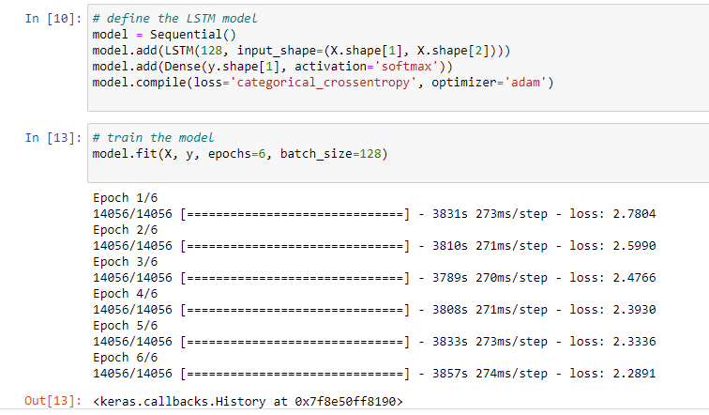
Training the model using sequential lstm, 1 dense layer, softmax activation function, and adam optimizer for 6 epochs

Slide 7

GENERATING TEXT WITH LSTM
Once the LSTM model is trained, it can be used to generate new text by predicting the next word in a sequence given the previous words. This can be done using a sampling technique that balances between exploring new possibilities and exploiting the most likely ones.
We run the Neural Network for 6 epochs due to computation power limitation. We save the trained model into a pkl ﬁle. This saved model is further used to generate output from a random prompt picked from within the trained txt ﬁle, and the model outputs text generation based on the input prompt.

Slide 8

APPLICATIONS OF LSTM LANGUAGE GENERATION
LSTM Language Generation has a wide range of applications such as chatbots, content creation, and language translation. It can also be extended to generate other types of data such as images and music.
Our project application being the chatbot that is trained and produces output based on the text corpus of the e-book.

Slide 9
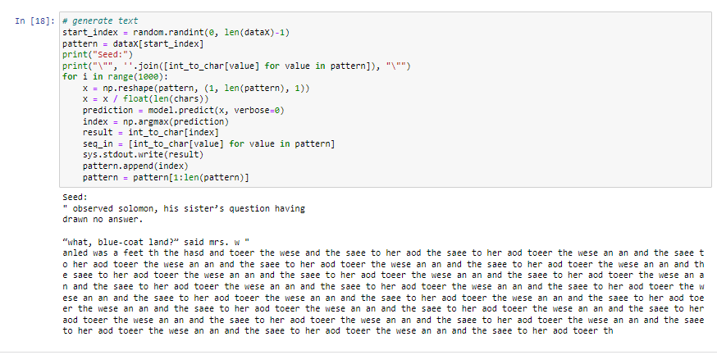
Generating output for the language generation model seed is the randomly picked input

Slide 10


CONCLUSION
In conclusion, LSTM Language Generation is a powerful tool that allows us to generate human-like text. With more advancements in Natural Language Processing, we can expect to see more innovative applications of this technology in the future.
TEAM ML STRIKE 3

Slide 11

THANKYOU !
TEAM ML STRIKE 3

